Slide 1
The Spectrum
Presented by: Zachary Samach, Jean-Baptiste Turroc,
Vivian Wong and Nancy Wu

Slide 2
Current System
Traditional Paper Filing System
Complex
Access Time
Editing and Communication
Security
Notes:
Talk about current system and its faults

Slide 3
There is always room for improvement!
Notes:
Talk about forms and reports and how they are useful to the company

Slide 4
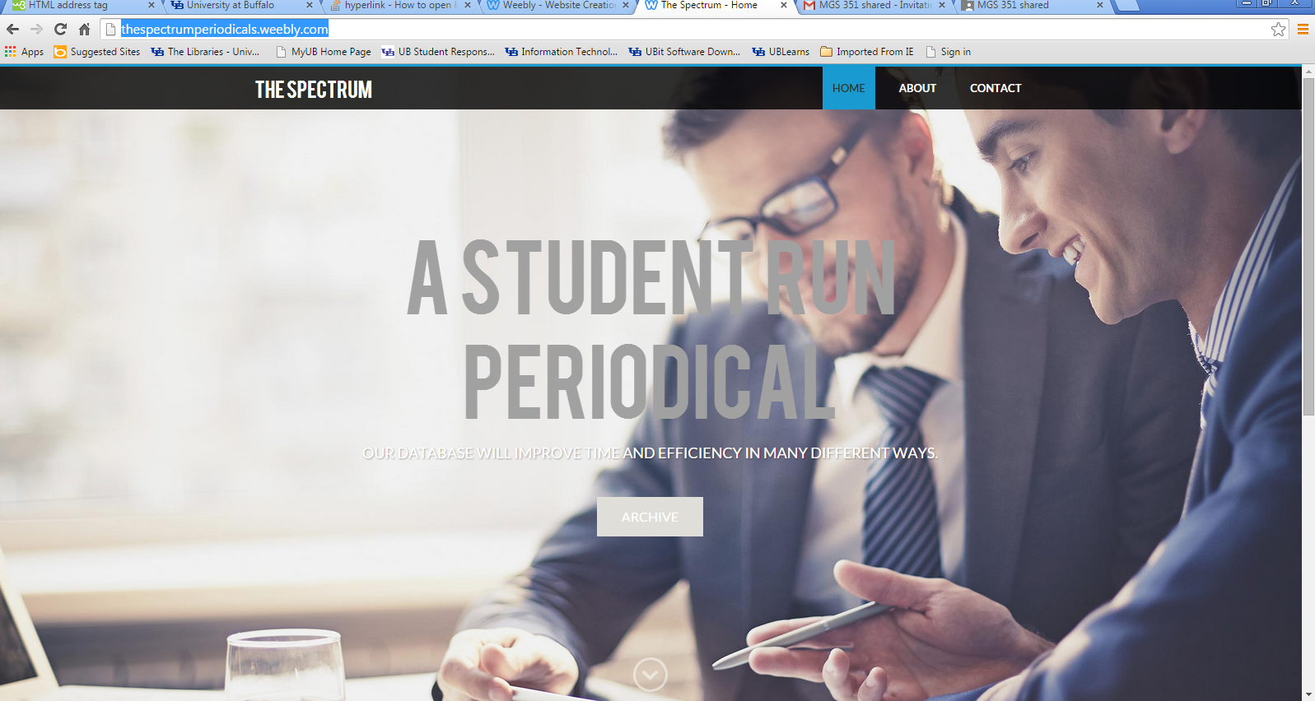
Website
Notes:
Show website

Slide 5
Conclusion
Our Database
Reduced data redundancy
Improved ease of access
Improve decision making
Notes:
Conclude on why the data base is useful and what it could help the company gain. In terms of revenue or profit.

